Slide 1

DATA STRUCTURE WEEK TWELVE
Contact Details:
Email: sobia.iftikhar@nu.edu.pk
GCR:

Slide 2
Content
Binary Tree
Full Binary Tree
Full Binary Tree
Perfect Binary Tree
Complete Binary Tree
Balance Binary tree
Binary Search Tree
AVL (Adelson-Velskii and Landis)

Slide 3
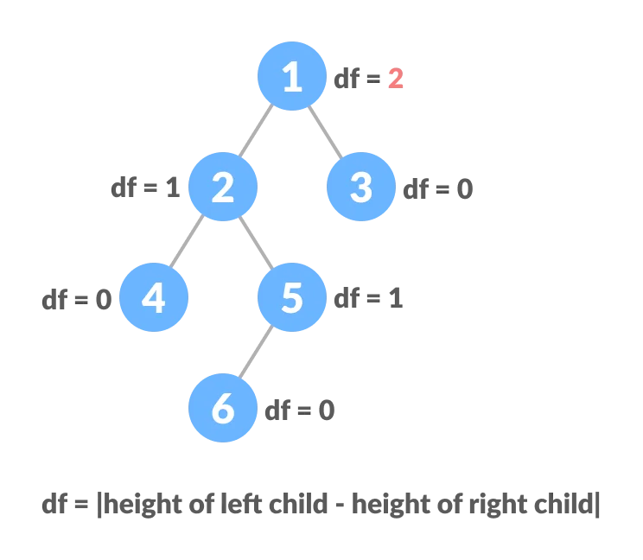
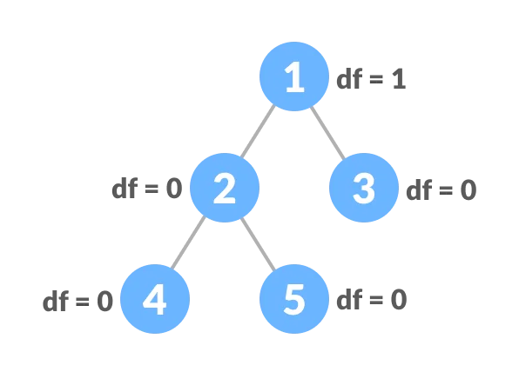
Balance Binary Tree
A balanced binary tree, also referred to as a height-balanced binary tree, is defined as a binary tree in which the height of the left and right subtree of any node differ by not more than 1.

Slide 4
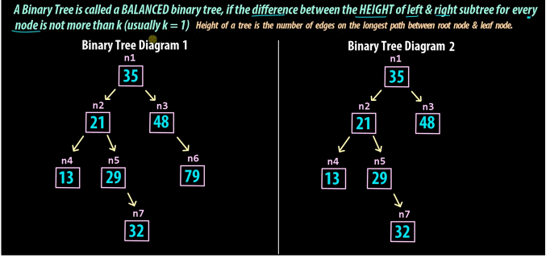
Balance Binary Tree

Slide 5

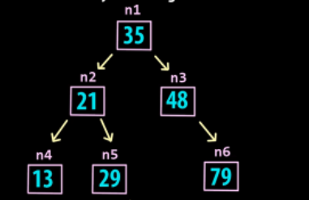





Why we need a balanced binary tree

Slide 6
AVL TREE
AVL tree is a self-balancing Binary Search Tree (BST) where the difference between heights of left and right subtrees cannot be more than one for all nodes.
Avl operation :
Insert
Delete
Right Right Rotation
Left Left Rotation
Right Left Rotation
Left Right Rotation

